Slide 1
Refining
Data
Real-Time Trend Analysis Pipeline for Spotify
Gathering
Data
Exploratory
Data
Analysis
Data
Modelling
Deployment
Model
Evaluation

Slide 2




About Us
Refining
Data
Real-Time Trend Analysis Pipeline for Spotify
Gathering
Data
Exploratory
Data
Analysis
Data
Modelling
Deployment
Model
Evaluation
Chanakya Samsani
Business Analyst
Bikram Chand
Data Engineer
Sai Charan Chandu
DevOps Engineer
Chethan Chakradhar
ML Engineer

Slide 3
Real-Time Trend Analysis Pipeline for Spotify
Project Objective
About Us
Business Questions
Refining
Data
Develop a scalable and robust data engineering pipeline for real-time trend analysis of Spotify streaming data.
Gathering
Data
Exploratory
Data
Analysis
Data
Modelling
Deployment
Chanakya Samsani
Business Analyst
Bikram Chand
Data Engineer
Sai Charan Chandu
DevOps Engineer
Chethan Chakradhar
ML Engineer
Model
Evaluation

Slide 4
About Us
Business Questions
Project Objective
Proposed Solutions
Refining
Data
What are the steps are being taken to protect business data and ensure cyber security?
Develop a scalable and robust data engineering pipeline for real-time trend analysis of Spotify streaming data.
Gathering
Data
Exploratory
Data
Analysis
Data
Modelling
What are the emerging trends in business and how can we capitalize on them?
Deployment
Model
Evaluation
Chanakya Samsani
Business Analyst
Bikram Chand
Data Engineer
Sai Charan Chandu
DevOps Engineer
Chethan Chakradhar
ML Engineer

Slide 5
About Us
Project Objective
TITLE
Our Approach
Proposed Solutions
Business Questions
We secure data through encryption, multi-factor authentication, and ongoing monitoring, ensuring a resilient cybersecurity framework.
Refining
Data
What are the steps are being taken to protect business data and ensure cyber security?
Gathering
Data
Exploratory
Data
Analysis
Personalized content, AI driven recommendations and interactive user experiences are top emerging trends that we can capitalize to improve business
What are the emerging trends in business and how can we capitalize on them?
Data
Modelling
Deployment
Model
Evaluation
Refining
Data
Gathering
Data
Exploratory
Data
Analysis
Data
Modelling
Deployment
Model
Evaluation
Develop a scalable and robust data engineering pipeline for real-time trend analysis of Spotify streaming data.

Slide 6
About Us
Business Questions
TITLE
using CRISP-DM
Our approach
Proposed Solutions
We secure data through encryption, multi-factor authentication, and ongoing monitoring, ensuring a resilient cybersecurity framework.
Refining
Data
What are the steps are being taken to protect business data and ensure cyber security?
Gathering
Data
Exploratory
Data
Analysis
Personalized content, AI driven recommendations and interactive user experiences are top emerging trends that we can capitalize to improve business
Data
Modelling
What are the emerging trends in business and how can we capitalize on them?
Deployment
Model
Evaluation
Chanakya Samsani
Business Analyst
Bikram Chand
Business Analyst
Sai Charan Chandu
Business Analyst
Chetan Chakradhar
Business Analyst
Chanakya Samsani
Business Analyst
Bikram Chand
Business Analyst
Sai Charan Chandu
Business Analyst
Chetan Chakradhar
Business Analyst

Slide 7

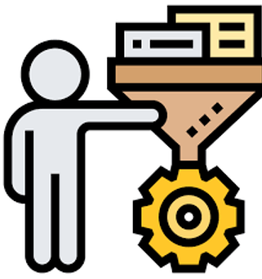

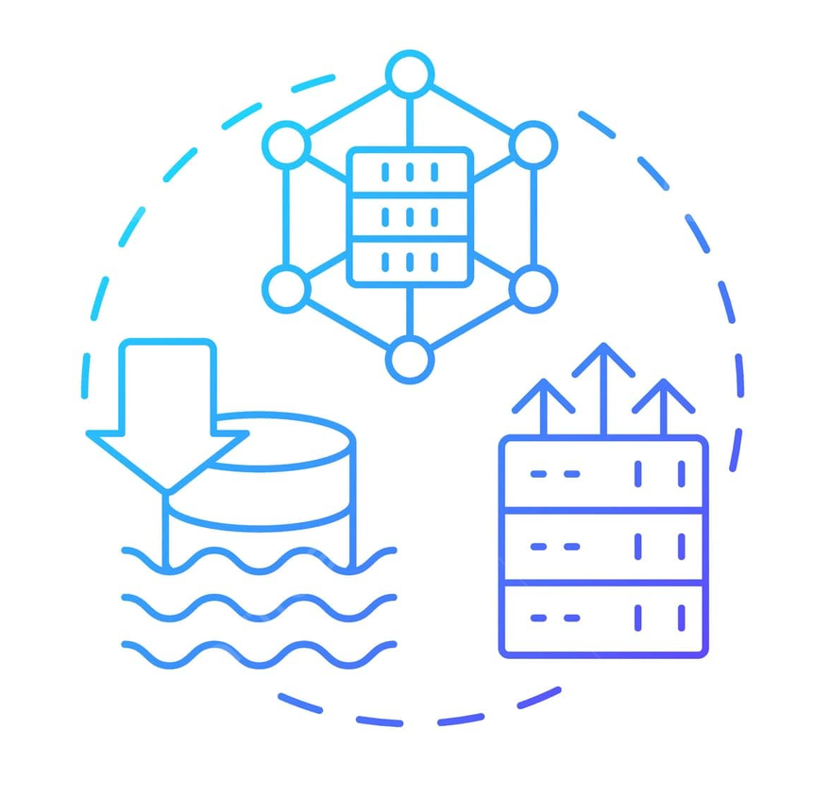
About Us
Business Questions
Proposed Solutions
Technology Used
using CRISP-DM
Our approach
with Data Pipeline
Gathering
Data
We secure data through encryption, multi-factor authentication, and ongoing monitoring, ensuring a resilient cybersecurity framework.
Refining
Data
Storage
Analysis
& Visualization
Deployment
Ingestion
Processing
Personalized content, AI driven recommendations and interactive user experiences are top emerging trends that we can capitalize to improve business
Model
Evaluation
Exploratory
Data
Analysis
Data
Modelling
Chanakya Samsani
Business Analyst
Bikram Chand
Business Analyst
Sai Charan Chandu
Business Analyst
Chetan Chakradhar
Business Analyst

Slide 8
About Us
Business Questions
Proposed Solutions
using CRISP-DM
Technology Used
with Data Pipeline
Our approach
Storage
Analysis
& Visualization
Ingestion
Processing
Deployment
Model
Evaluation
Gathering
Data
Data
Modelling
Refining
Data
Exploratory
Data
Analysis
Chanakya Samsani
Business Analyst
Bikram Chand
Business Analyst
Sai Charan Chandu
Business Analyst
Chetan Chakradhar
Business Analyst

Slide 9
About Us
Business Questions
Proposed Solutions
using CRISP-DM
Technology Used
Technology
with Data Pipeline
Our approach
Storage
Analysis
& Visualization
Ingestion
Processing
Deployment
Model
Evaluation
Gathering
Data
Data
Modelling
Refining
Data
Exploratory
Data
Analysis
Chanakya Samsani
Business Analyst
Bikram Chand
Business Analyst
Sai Charan Chandu
Business Analyst
Chetan Chakradhar
Business Analyst

Slide 10
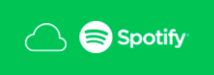














About Us
Business Questions
Proposed Solutions
with Data Pipeline
Our approach
Technology
Thank
You!
Chanakya Samsani
Business Analyst
Bikram Chand
Business Analyst
Sai Charan Chandu
Business Analyst
Chetan Chakradhar
Business Analyst

Slide 11
About Us
Business Questions
Proposed Solutions
with Data Pipeline
Our approach
Technology
Thank
You!
Chanakya Samsani
Business Analyst
Bikram Chand
Business Analyst
Sai Charan Chandu
Business Analyst
Chetan Chakradhar
Business Analyst

